Slide 1
Designing Malware for modern red-teaming & tradecraft adversary
Satria Ady Pradana

Slide 2
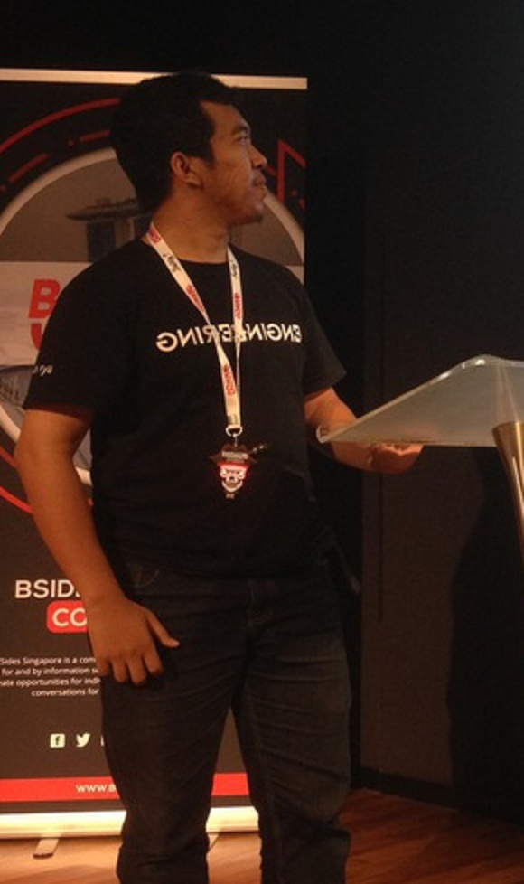



Who?
Satria Ady Pradana
Cyber Security Consultant at Mitra Integrasi Informatika
Director of Curriculum at Archonlabs SSD
Penetration Tester, Red Team
Community Leader of Reversing.ID
@xathrya
xathrya
xathrya_

Slide 3
Background story

Slide 4
Red Teaming
Originate from military practices.
Evaluate security posture by playing as aggressor.
Full-scope, multi-layered attack simulation designed to measure how well organization’s security controls can withstand attack from real-life adversaries.

Slide 5
Requirement
Deep knowledge of systems (computer system, protocols, libraries, etc).
Ability to think outside the box.
Software development skills.
Penetration testing skills
Social engineering.

Slide 6
When doing Red Teaming
Long time engagement (1 – 3 months at minimum).
Penetrate as deep as possible, maintain persistence, pivoting, exfiltrate critical information.
It means you need a way to keep your presence in the network!

Slide 7
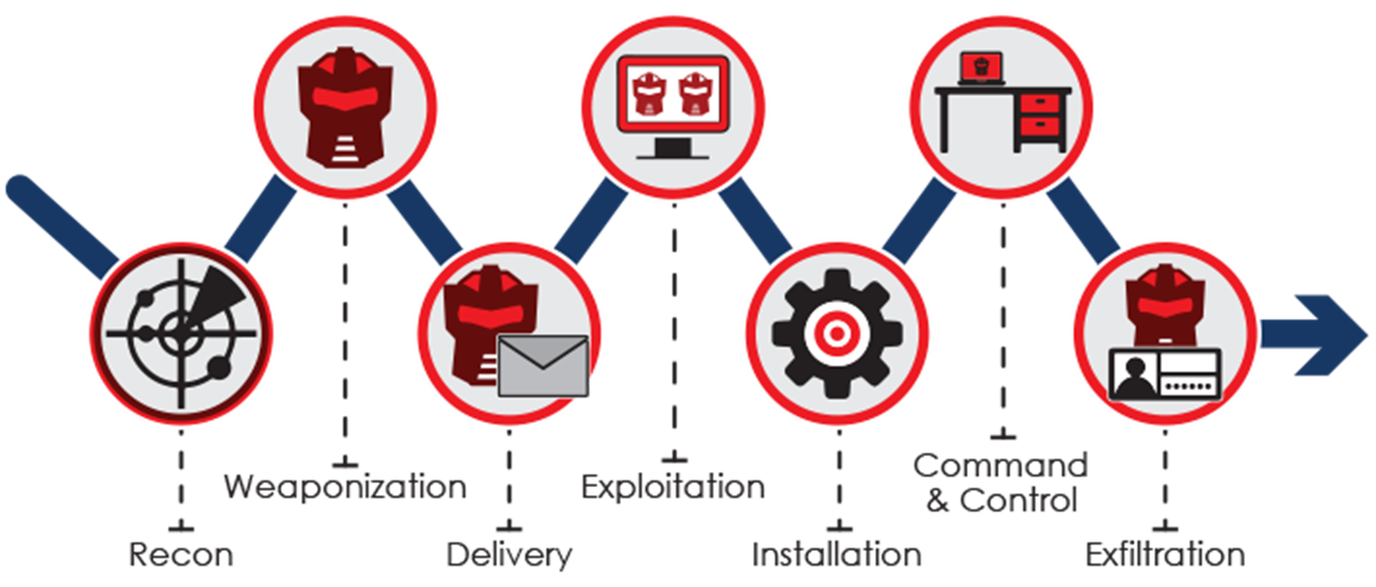
The Cyber Kill Chain

Slide 8
Why Python?
Simple and clean structure
Designed for rapid prototyping
Extensive library

Slide 9
Where to Start?

Slide 10
Designing Implant
What is the purpose of the implant?
What success look like?
Which feature or capabilities we need?

Slide 11
Designing Implant
Lightweight: can be dropped through macro-enabled office document.
Evasive: evade most common products without much adaptation
Functional: collect information about target environment to aid in further operations.

Slide 12
Terms
Command and Control attacker-controlled infrastructure which maintain control over all agents or implants by send command and retrieve the result. Alternative name: C&C, C2 server
Implant agent, small program which executed on target. Alternative name: RAT, backdoor, beacon.
Loader specific code or executable which purpose is to load the payload (implant) or other loader.

Slide 13
Terms
Redirectors Node or system which proxies all traffic from target network (implant) to C2 server, hiding the true location of the C2 server.

Slide 14
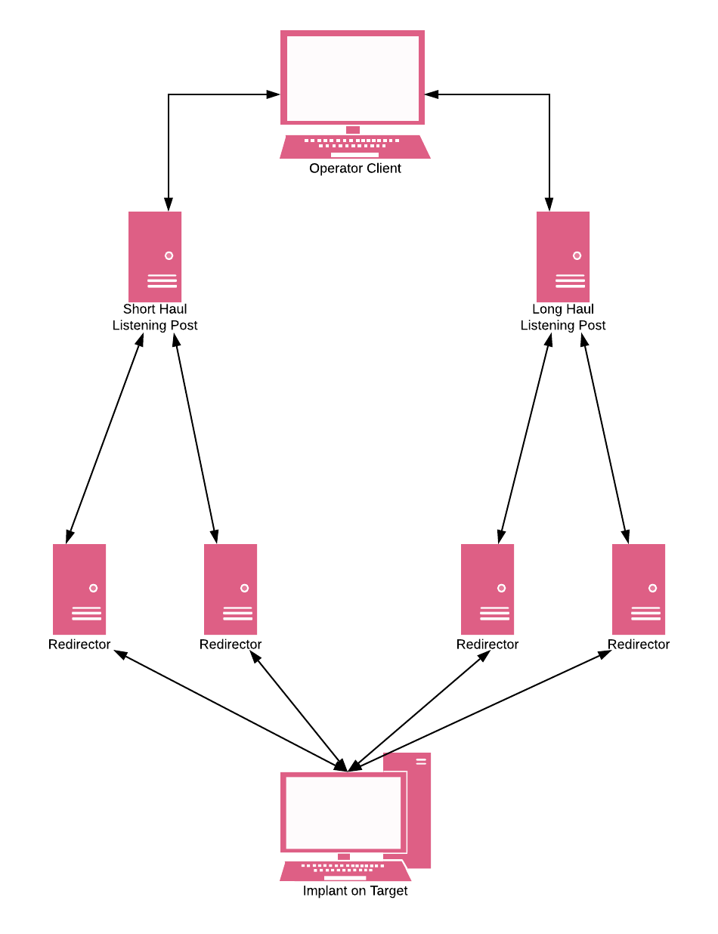
Robust Infrastructure
Interactive (Tier 3)
General command, enumeration, scanning, data exfiltration, etc.
Has most interaction and at greatest risk of exposure.
Ready to abandon at any time.
Multiple tiers

Slide 15
Robust Infrastructure
Short Haul (Tier 2)
As a backup to reestablish interactive session.
Use covert communications that blend with target.
Slow callback times, i.e. 1 – 24 hours.
Multiple tiers

Slide 16
Robust Infrastructure
Long Haul (Tier 1)
Maintain long-term access into target’s network.
Same as short haul, but slower.
Multiple tiers

Slide 17
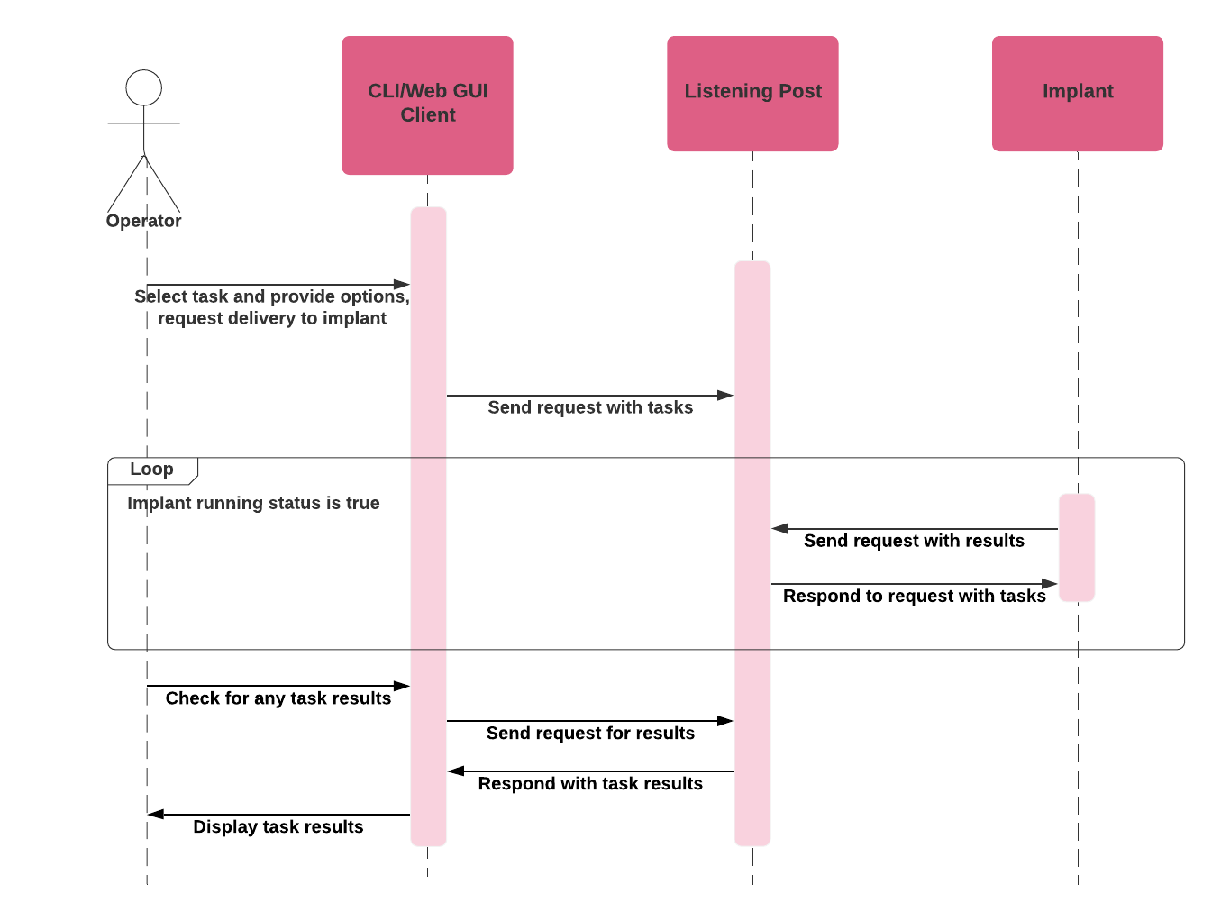

Slide 18
Minimum Requirement
Communication Channel
Modular Design
Dynamic Reconfigurable

Slide 19
Planning for Operation

Slide 20
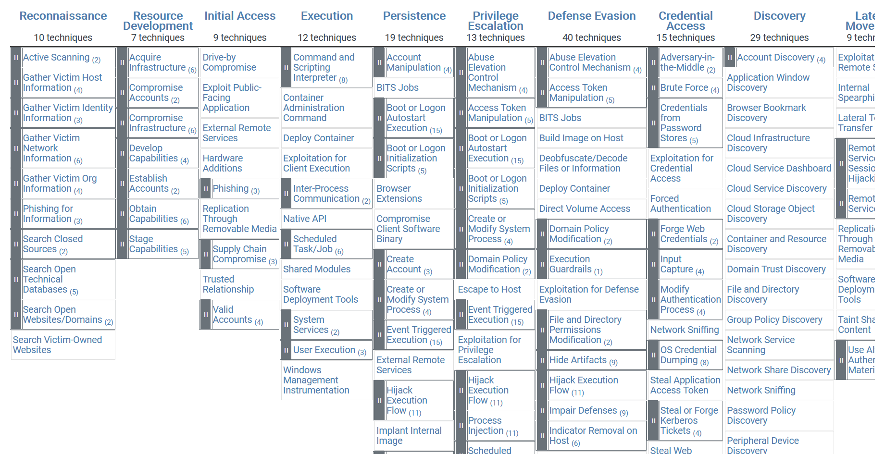
MITRE ATT&CK
https://attack.mitre.org/

Slide 21
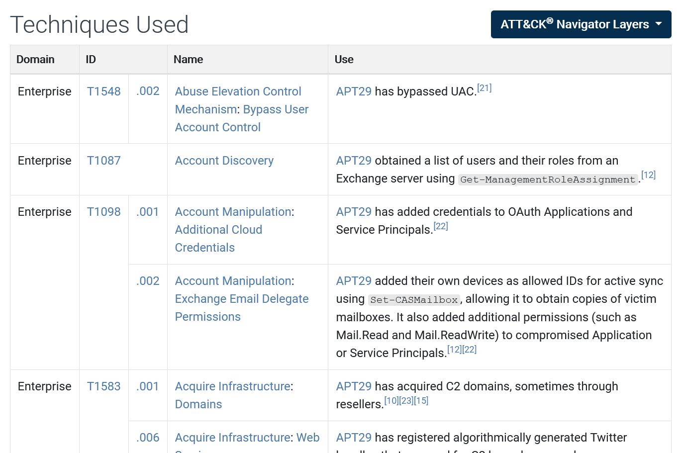
https://attack.mitre.org/groups/G0016/

Slide 22
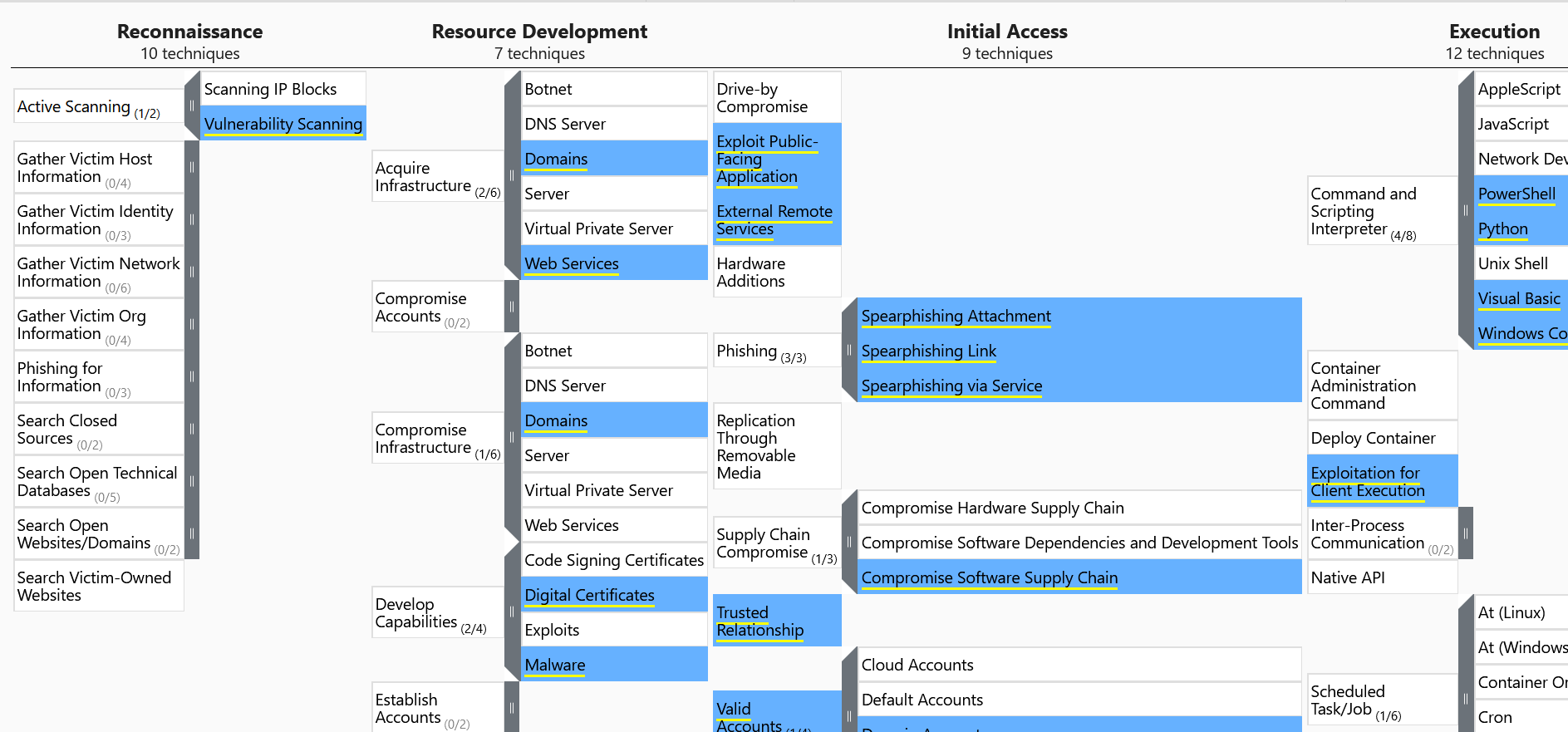

Slide 23
Design & Implementation

Slide 24
Communication Channel
HTTP/HTTPS: masquerade as legitimate HTTP connections
DNS:
Hybrid: DNS for telemetry or callback, HTTP for data channel.
Pure DNS
SMB: chaining beacons
TCP: with proprietary protocols

Slide 25
Case: HTTP
import requests
url = GenerateURL()
headers = GenerateHeaders()
body = GenerateBody()
res = requests.post(url, data=body, headers=headers)
ProcessResponse(res)
Message Type:
Callback
Command
Result
Dynamic URL and endpoint?
Unique ID
Payload, where?
Interval and jitter
Telemetry, health check

Slide 26
Modular Design
Adding new features/capabilities should not changes the core program.
Framework?
Implement feature as addon or plugins
Use builtin or Windows API?
Stages? Stageless?

Slide 27
Case: Commands
GET
PUT
LIST
EXECUTE
LOAD
Module: credential harvesting,
CONFIGURE: key, channel, IP, port, host, endpoint

Slide 28
Case: WMI Command
Windows Management Interface
Query system state (process, services, installed apps, bios, etc)
WQL (WMI Query Language)
Module: wmi
pip install wmi
Extending implant with WMI command

Slide 29
Command: execute shellcode
Raw shellcode as payload
Why shellcode?
Run as separate thread
Allocate space on host process
Decrypt/decompress/decode shellcode to allocated space
Create new thread and start execution from allocated space
Clean up

Slide 30
Command: DROP & Execute Binary
Fetch executable from C2 server
Mostly tools: Rubeus, mimikatz, message relay
Store the executable temporary
What about DLL?

Slide 31
Command: Shell command
Execute shell command
Atomic or session?
Variations
os.command()
subprocess.run()
subprocess.Popen()

Slide 32
Dynamic Reconfigurable
Change settings/configurations at runtime.
IP address + endpoint
Message type
Profile
Should match with C2 server

Slide 33
Protection
Any tool deployed in target environment needs to adhere to the highest standard of operational security (opsec)

Slide 34
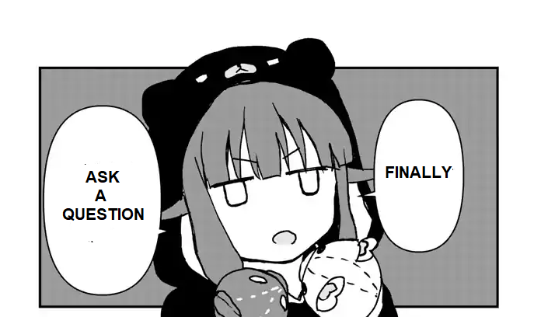

Slide 35
Thank You
Satria Ady Pradana
satria.pradana [at] mii.co.id
@xathrya (telegram)

